Slide 1

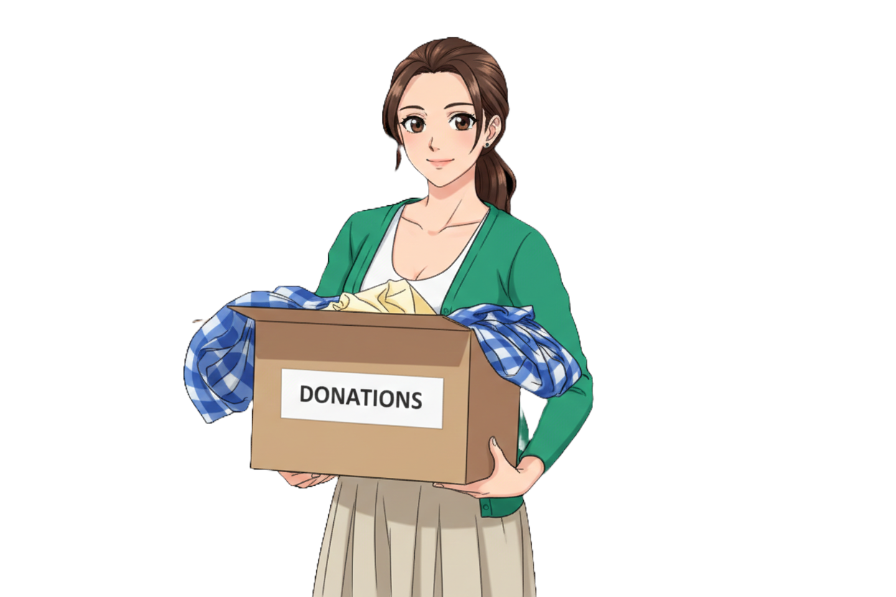


Altruism In Human Nature
Why do we help others?
A Presentation By:
Yug Sharma
NOT MY ART

Slide 2

An Attempt to Understand Human Nature.
Humans are social beings
Survival depends on cooperation
Self-interest often dominates
Empathy exists naturally
Morality shapes behavior

Slide 3

What is Altruism?
Helping others without reward
Involves personal sacrifice
Driven by empathy
Seen across cultures
Exists beyond obligation
Notes:
Click to add Notes

Slide 4
Why are we Altruistic?
1. Biology 2. Psychology 3. Social Values
4. Personal Interests

Slide 5

Biology
Helping improves group survival
Kin selection explains sacrifice
Genes favor cooperation
Evolution rewards helpers
Survival extends beyond self

Slide 6

Psychology
Empathy motivates helping
Moral values influence actions
Guilt encourages altruism
Positive emotions reinforce helping
Learned behavior matters
Personality affects generosity

Slide 7

Social Values
Culture teaches helping norms
Society rewards altruism
Religion promotes selflessness
Family shapes values
Role models inspire helping
Social pressure influences behavior

Slide 8

Persona Interests
Altruism feels rewarding
Helping benefits helper
Selflessness isn’t absolute
Motives often mixed
Cooperation serves survival

Slide 9

What Limits Altruistic Nature?
Fear prevents helping
Risk reduces altruism
Bystander effect occurs
Diffusion of responsibility exists
Self-preservation intervenes
Context shapes decisions

Slide 10

Conclusion
Humans possess an innate capacity to help others.
Altruism appears depending on situation and context.
Evolution and genetics encourage cooperative behavior.
Culture, norms, and upbringing guide helping actions.
Humans weigh personal cost against helping others.
Altruism connects individuals into functioning societies.

